Slide 1
The Value of Earnings
Mike Scott
6/3/11

Slide 2
Forward
This study done in accordance with HGS box definitions by Ian Woodward applied to IBD MarketSmith earnings database

Slide 3
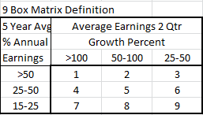
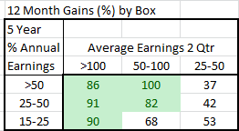
Nine Box Matrix
Computed data as of 6/3/11
Box 7 Turn Around Stocks
Applied additional strong sales growth criteria

Slide 4
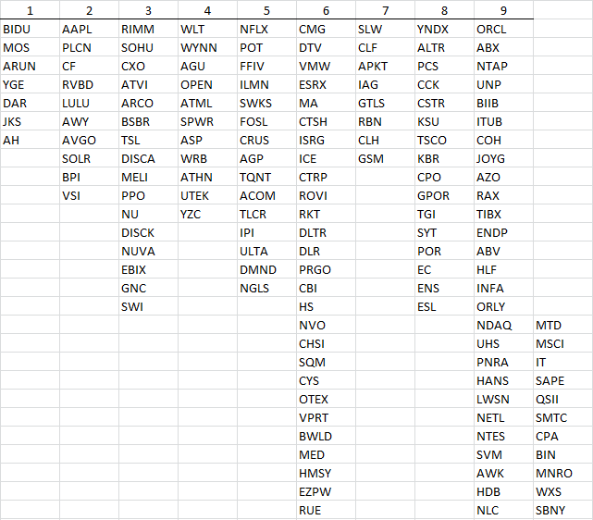
Box Stocks
All stocks in the database trading above $5 and
Liquidity > $10M/day that meet Box definitions

